Slide 1
Exploring MLRSNet: A Game – Changer in Remote Sensing
10-Sept-24
Disha Ghosh & Nizaanth Raja
MSc. Data Science & MSc. Computational Science

Slide 2
Welcome to our presentation
Objective: To introduce and explore the MLRSNet dataset, while comparing the performance of the EfficientNet B0 base model (with pre-trained weights) to other models using pre-trained weights as mentioned in the original paper. Additionally, this work also involves training the EfficientNet B0 model from scratch for further comparison.
Deep Learning, MLRSNet | Disha Ghosh & Nizaanth Raja | Page 1

Slide 3
Outline
1. Brief Overview of the MLRSNet Dataset
- Introduction to the MLRSNet dataset and its significance in remote sensing image classification.
2. Exploratory Data Analysis (EDA)
- Visualizations for images per category / label.
3. EfficientNet Model
- Architecture and problem formulation.
4. Experimental Setup
- Experimental Protocols (train / validation / test distribution, pre-trained & training from scratch, metrics, etc.)
- Hyperparameters (Package, Batch size, learning rate, epochs, optimizer)
5. Results and Visualizations
- Model performance and comparison with state – of – art models mentioned in the paper.
6. Summary
- Key findings and insights.
- Limitations and potential enhancements.
Deep Learning, MLRSNet | Disha Ghosh & Nizaanth Raja | Page 2

Slide 4
MLRSNet Dataset Overview
1. Purpose: Designed for multi-label classification of remote sensing images
2. Total Images: 109,161 high spatial resolution optical satellite images
3. Image Size: 256×256 pixels
4. Categories: 46 categories, including both natural and man-made objects
        Sample Size per Category: 1,500 to 3,000 images
5. Labels: 60 predefined class labels
        Labels per Image: Ranges from 1 to 13
6. Geographical Diversity: Images represent various geographical locations and environmental conditions, which helps in training models that generalize well across different regions.
7. Use Case: Enhances the development of robust machine learning models for remote sensing applications by providing a diverse and comprehensive dataset, which helps in pushing the boundaries of machine learning models in terms of accuracy and generalization.
Deep Learning, MLRSNet | Disha Ghosh & Nizaanth Raja | Page 3

Slide 5
Difference Between Categories and Labels
Labels | Categories
1. ‘Labels’ are referred to the specific labels assigned to each image in the dataset, indicating the presence of certain features or characteristics within that image. There are 60 pre-defined labels. | 1. “Categories" refer to the different types of scenes or land-use and land-cover types that are represented in the dataset. There are 46 distinct categories in total.
2. These labels include cloud, desert, farmland, intersection and buildings. | 2. These categories include various broad scene types like Residential, Industrial, Farmland, Forest, Water, Airport, and Highway.
Deep Learning, MLRSNet | Disha Ghosh & Nizaanth Raja | Page 4

Slide 6
EDA – Understanding Data
Exploratory Data Analysis (EDA) provided valuable insights into the characteristics of the MLRSNet dataset.
The initial analysis involved summarizing the dataset's statistical properties, including the distribution of images across various categories and the frequency of occurrence for each label.
Source: Exploratory Data Analysis_MLRSNet
Deep Learning, MLRSNet | Disha Ghosh & Nizaanth Raja | Page 5

Slide 7
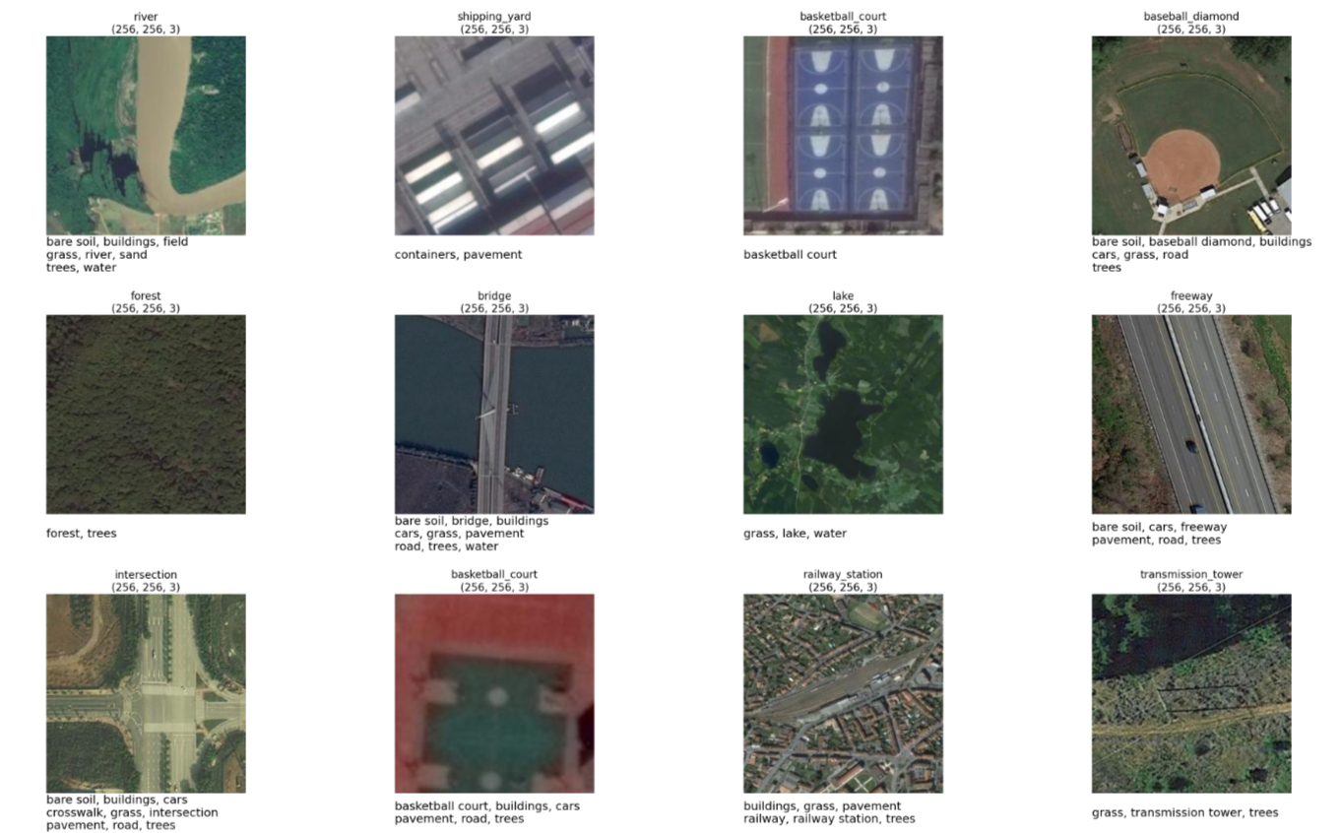
EDA Visualisations
Fig.1. Labels and Categories for each image
Deep Learning, MLRSNet | Disha Ghosh & Nizaanth Raja | Page 6

Slide 8
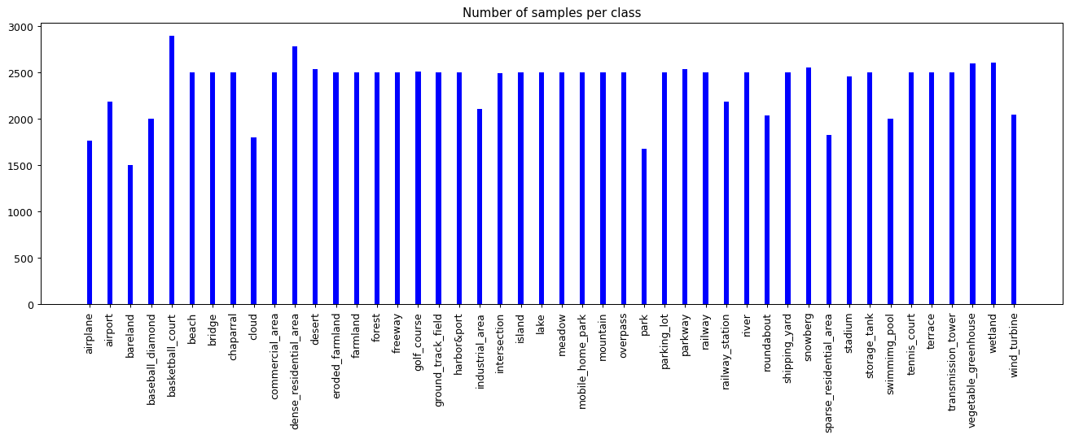
Samples per category
Fig.2. Distribution of Number of samples per category
Deep Learning, MLRSNet | Disha Ghosh & Nizaanth Raja | Page 7

Slide 9
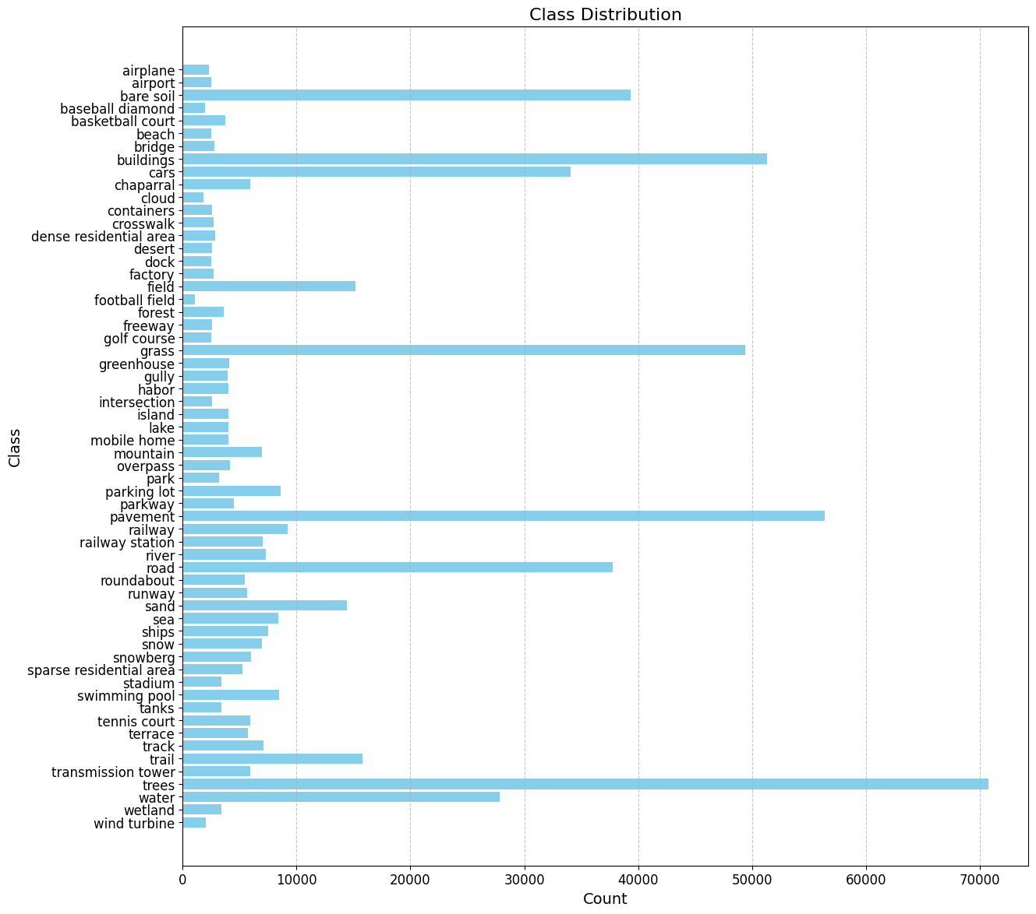
Fig.3. Distribution of Number of samples per Label
Deep Learning, MLRSNet | Disha Ghosh & Nizaanth Raja | Page 8

Slide 10
Key Concepts in EfficientNets
Depth (D): The depth of a neural network refers to the number of layers, or more specifically, the number of convolutional layers or blocks in the network.
Width (W): The width of a neural network refers to the number of channels (also known as filters or feature maps) in a convolutional layer. In other words, it represents how many neurons (or units) are there in each layer.
Resolution (R): The resolution of a network refers to the input image size. Higher resolution means the network processes larger images, which contain more details.
The challenges associated with scaling either of these are as follows:
Increasing depth can lead to vanishing gradients and overfitting.
Increasing width can cause model redundancy and excessive computational demand.
Increasing resolution requires significantly more memory and processing power.
Deep Learning, MLRSNet | Disha Ghosh & Nizaanth Raja | Page 9

Slide 11
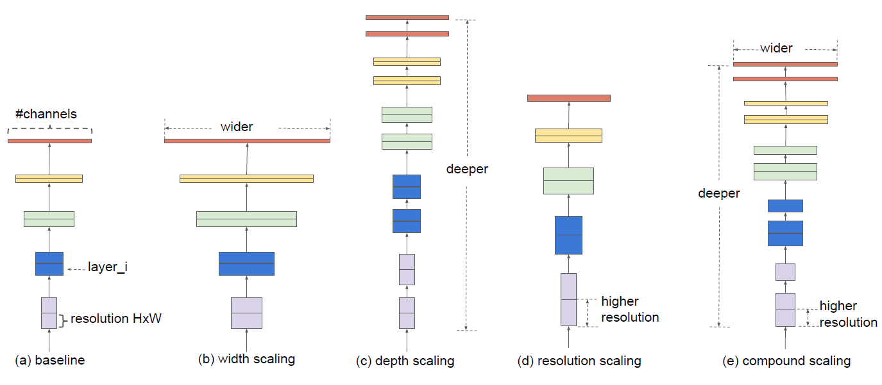
EfficientNet’s Novel Approach - Compound Scaling
Fig.4. Model Scaling Visualisation. (a) is a baseline network example; (b)-(d) are conventional scaling that only increases one dimension of network width, depth, or resolution. (e) is our proposed compound scaling method that uniformly scales all three dimensions with a fixed ratio.
Source: Original Paper
Deep Learning, MLRSNet | Disha Ghosh & Nizaanth Raja | Page 10

Slide 12
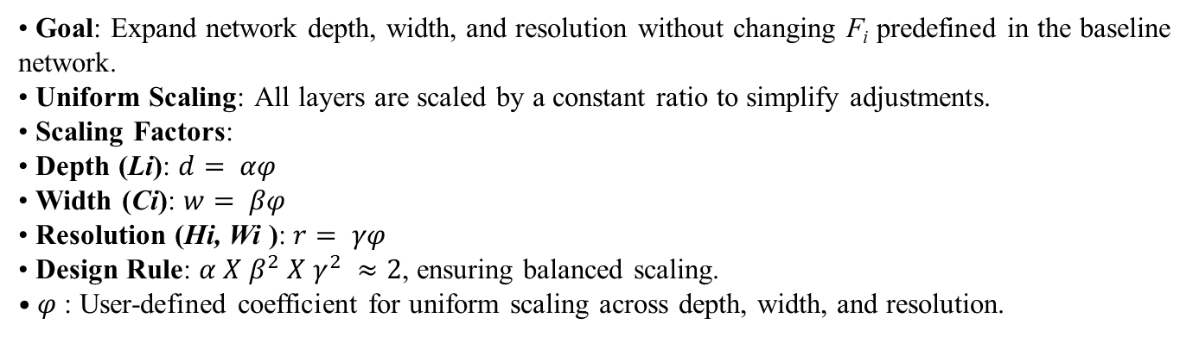
Problem Formulation for the Proposed Compound Scaling Method
Goal: Expand network depth, width, and resolution without changing F_{i} predefined in the baseline network.
Uniform Scaling: All layers are scaled by a constant ratio to simplify adjustments.
Scaling Factors:
Depth (Li): $d= αφ$
Width (Ci): $w= βφ$
Resolution (Hi, Wi ): $r= γφ$
Design Rule: $α X β^{2} X γ^{2} ≈2$, ensuring balanced scaling.
$φ$: User-defined coefficient for uniform scaling across depth, width, and resolution.
Deep Learning, MLRSNet | Disha Ghosh & Nizaanth Raja | Page 11

Slide 13
Architecture
The evaluation of the proposed scaling method was achieved using existing ConvNets but also develop a new mobile-size baseline called EfficientNet to better demonstrate its effectiveness.
Inspired by Tan et al. (2019) a baseline network (EfficientNet – B0) was developed using a multi-objective Neural Architecture Search (NAS) that optimizes both accuracy and FLOPS.
We use the same search space as Tan et al. (2019) and define the optimization goal as:
ACC(m) [FLOPS(m) / T] ^{w}
where ACC(m) and FLOPS(m) denote the accuracy and FLOPS of model m,T is the target FLOPS, and 𝑤 = -0.07 is a hyperparameter controlling the trade-off between accuracy and FLOPS.
The building block of this architecture is the mobile inverted bottleneck architecture MBConv (originally introduced in the MobileNetV2, a design reduces the number of parameters and computational costs while still delivering strong performance)), to which there is an addition of squeeze – and – excitation optimisation.(enhance the network's ability to focus on important features by adaptively recalibrating channel-wise feature responses).
Deep Learning, MLRSNet | Disha Ghosh & Nizaanth Raja | Page 12

Slide 14
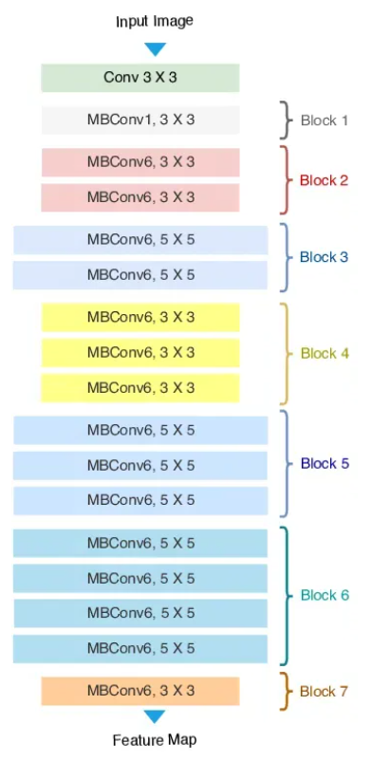
Architecture
Fig.5.EfficientNet Architecture
Have a look at the paper here!
Here,
kxk: kernel size.
MBConvk: Expansion Ratio for channels.
Blocks: Groupings of layers that progressively deepen the network and extract more abstract and complex features from the image.
Deep Learning, MLRSNet | Disha Ghosh & Nizaanth Raja | Page 13

Slide 15
Experimental Setup
Setup | Training | Validation | Testing | Pre - trained Weights
Split 1 | 20% | 10% | 70% | Yes (ImageNet)
Split 2 | 30% | 10% | 60% | Yes (ImageNet)
Split 3 | 40% | 10% | 50% | Yes (ImageNet)
Scratch Model | 70% | 10% | 20% | No
Table 1. Model Configurations
Deep Learning, MLRSNet | Disha Ghosh & Nizaanth Raja | Page 14

Slide 16
Experimental Setup
Hyperparameter Tuning
Package: Keras
Batch Size: 32
Learning Rate: 0.01
Epochs: 10
Optimizer: Adam
Metrics
F1 Score (Samples): Evaluates the balance between precision and recall for multi-label classification.
Mean Average Precision (mAP): Measures the precision across all class labels.
Deep Learning, MLRSNet | Disha Ghosh & Nizaanth Raja | Page 15

Slide 17
Results
CNNs | 20% | 30% | 40%
MLRSNet-InceptionV3 | 81.50 | 82.33 | 84.84
MLRSNet-VGGNet16 | 67.88 | 72.66 | 75.39
MLRSNet-VGGNet19 | 66.12 | 69.53 | 73.60
MLRSNet-ResNet50 | 82.65 | 84.28 | 86.01
MLRSNet-ResNet101 | 83.26 | 84.19 | 85.72
MLRSNet-DenseNet121 | 75.96 | 77.99 | 80.25
MLRSNet-DenseNet169 | 82.16 | 86.42 | 87.35
MLRSNet-DenseNet201 | 87.25 | 87.84 | 88.77
MLRSNet-EfficientNetB0 | 93.10 | 94.10 | 94.58
Table 2. Mean Average Precision (mAP): Comparison of our model with the other eight fine tuned model mentioned in the paper
Deep Learning, MLRSNet | Disha Ghosh & Nizaanth Raja | Page 16

Slide 18
Results
CNNs | 20% | 30% | 40%
MLRSNet-InceptionV3 | 0.7746 | 0.8016 | 0.8146
MLRSNet-VGGNet16 | 0.5743 | 0.6534 | 0.6855
MLRSNet-VGGNet19 | 0.5677 | 0.6120 | 0.6329
MLRSNet-ResNet50 | 0.7530 | 0.8176 | 0.8353
MLRSNet-ResNet101 | 0.7618 | 0.7703 | 0.8226
MLRSNet-DenseNet121 | 0.7154 | 0.7389 | 0.7571
0MLRSNet-DenseNet169 | 0.8138 | 0.8408 | 0.8521
MLRSNet-DenseNet201 | 0.8381 | 0.8414 | 0.8538
MLRSNet-EfficientNetB0 | 0.8355 | 0.8492 | 0.8539
Table 2. F1 Score (Samples): Comparison of our model with the other eight fine tuned model mentioned in the paper
Deep Learning, MLRSNet | Disha Ghosh & Nizaanth Raja | Page 17

Slide 19
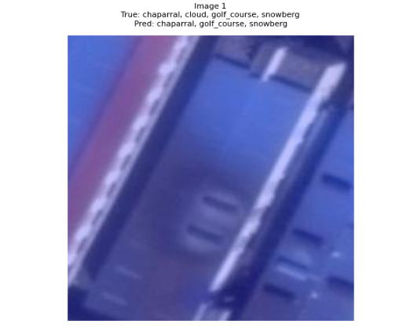
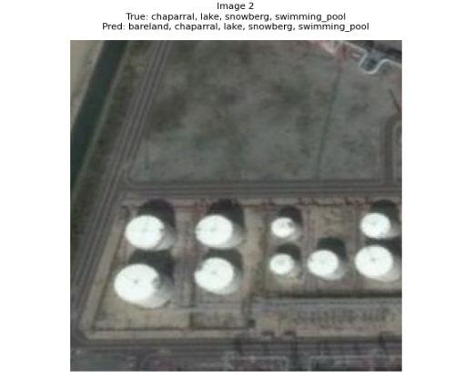
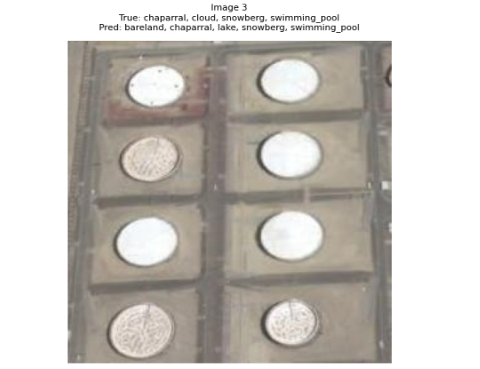
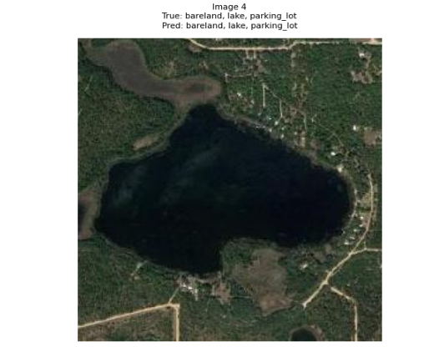
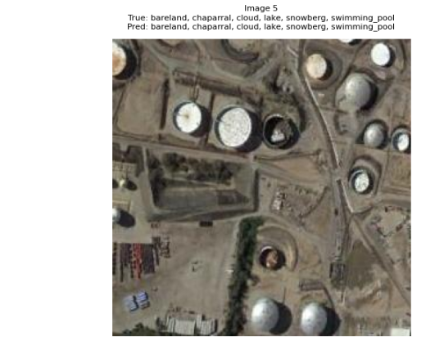
Visualizations for Base model for the split ratio 20-10-70.
Deep Learning, MLRSNet | Disha Ghosh & Nizaanth Raja | Page 18

Slide 20
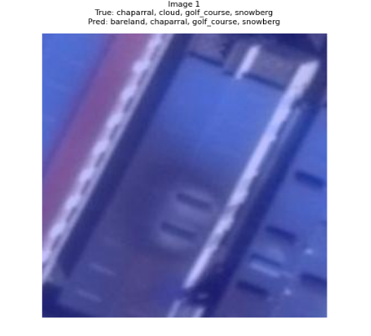
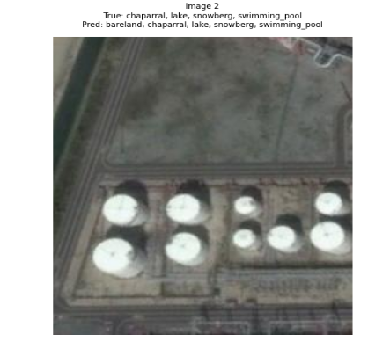
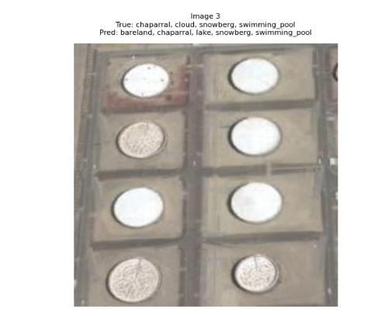
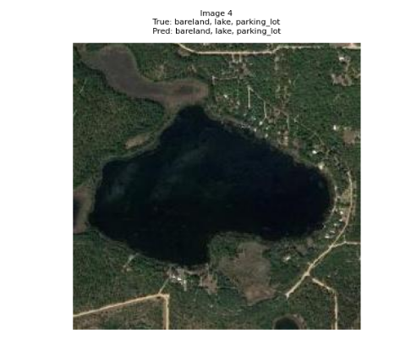
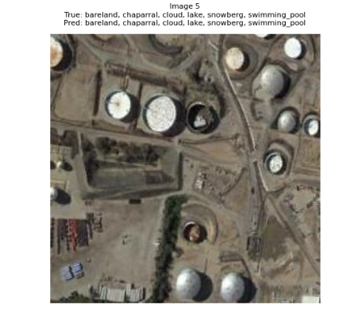
Visualizations for Base model for the split ratio 30-10-60.
Deep Learning, MLRSNet | Disha Ghosh & Nizaanth Raja | Page 19

Slide 21
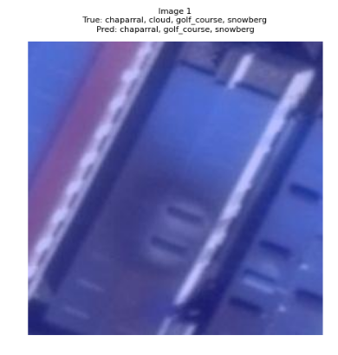
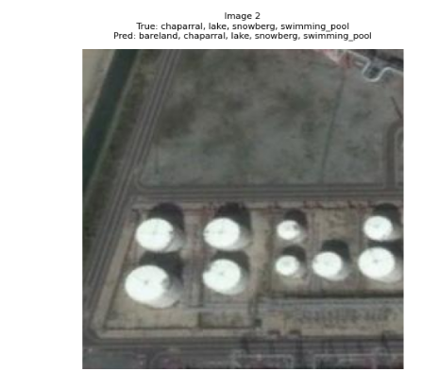
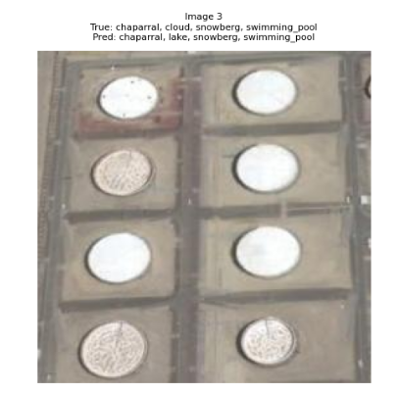
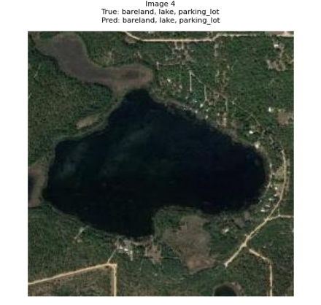
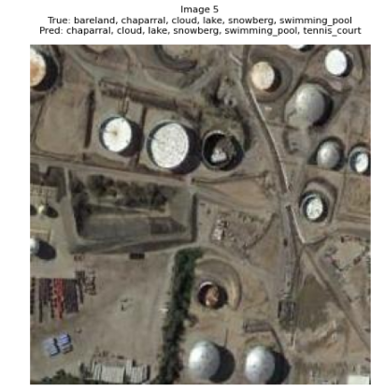
Visualizations for Base model for the split ratio 40-10-50.
Deep Learning, MLRSNet | Disha Ghosh & Nizaanth Raja | Page 20

Slide 22
Experimental Setup
For Performance Scheduling
BATCH_SIZE = 32
initial_learning_rate = 0.005
Epochs = 200
With Step Decay
Initial Learning Rate = 0.005
Decay Steps = 5
Decay Rate = 0.9
Epochs = 200
Deep Learning, MLRSNet | Disha Ghosh & Nizaanth Raja | Page 21

Slide 23
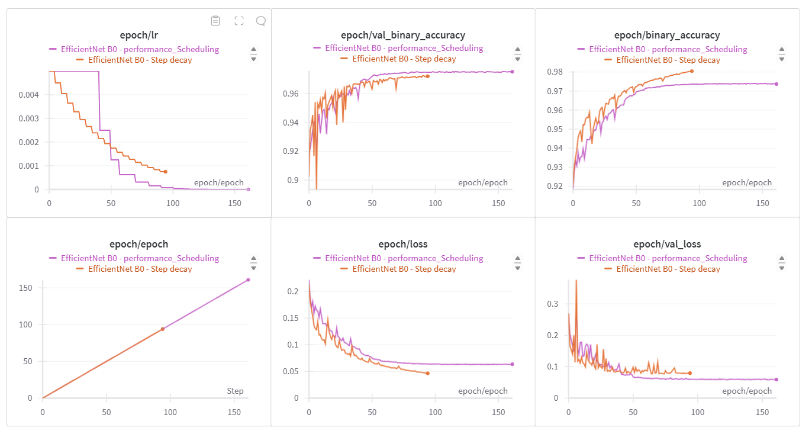
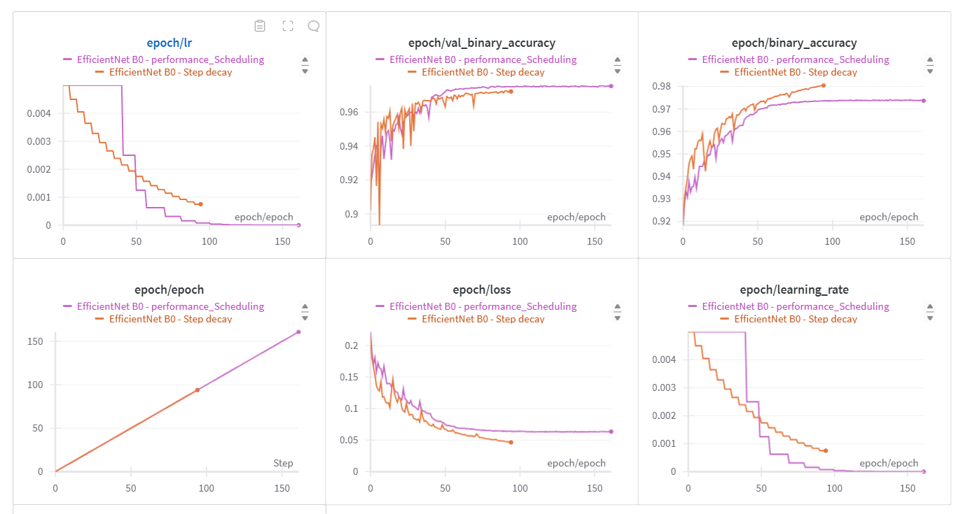
Comparison between the Step decay model and Performance Scheduling
Fig.6. Comparison between the two scratch models
Deep Learning, MLRSNet | Disha Ghosh & Nizaanth Raja | Page 22

Slide 24
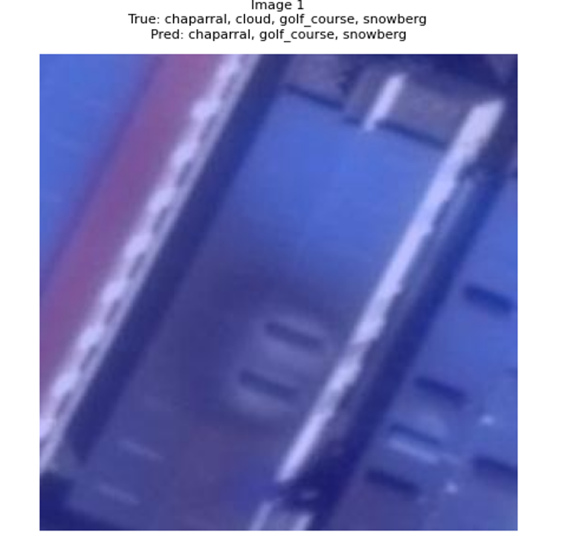
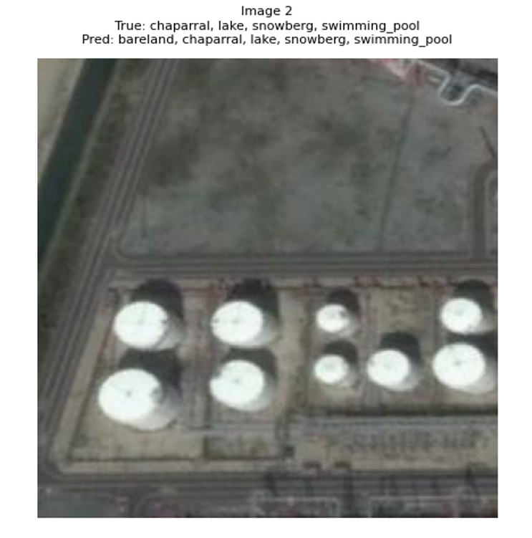
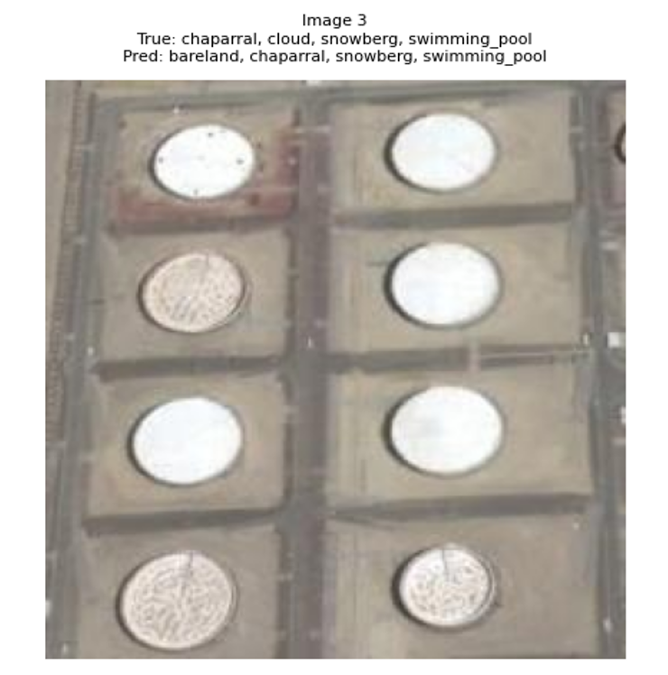
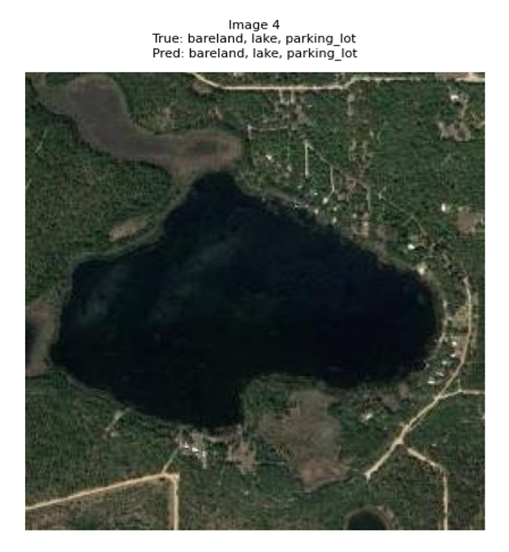
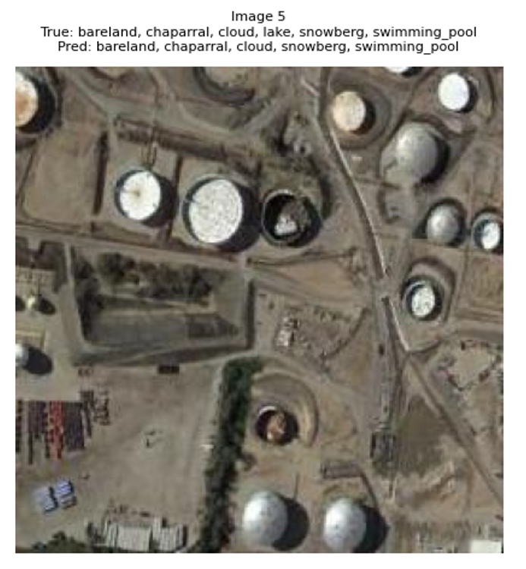
Results for Performance Scheduling
F1 Score (Samples): 0.8568 Binary Accuracy: 97.58 ROC AUC Score (samples): 99.22
Mean Average Precision (mAP): 94.61 Hamming Loss: 2.41
Deep Learning, MLRSNet | Disha Ghosh & Nizaanth Raja | Page 23

Slide 25
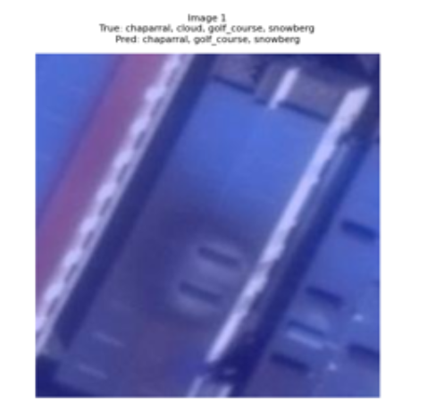
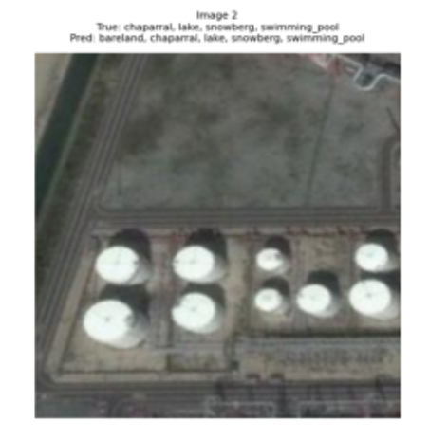
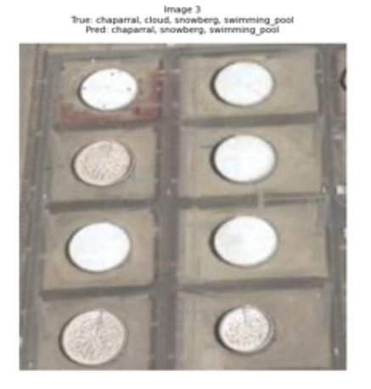
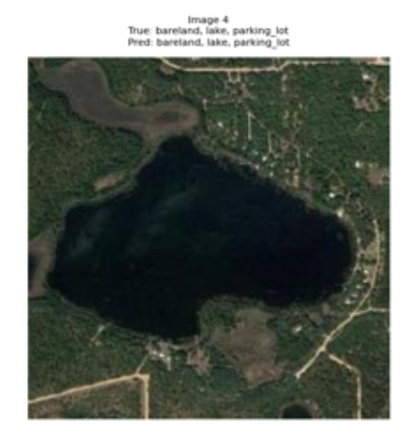
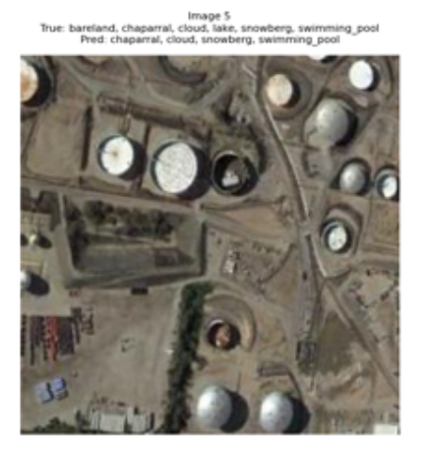
Results for Step Decay
F1 Score (Samples): 0.8395 Binary Accuracy: 97.15 ROC AUC Score (samples): 98.93
Mean Average Precision (mAP): 93.53 Hamming Loss: 2.84
Deep Learning, MLRSNet | Disha Ghosh & Nizaanth Raja | Page 24

Slide 26
References and Links
Wandb Report to EfficientNet Base Model B0 for the Split Ratio: 20-10-70.
Wandb Report to EfficientNet Base Model B0 for the Split Ratio: 30-10-60.
Wandb Report to EfficientNet Base Model B0 for the Split Ratio: 40-10-50.
Comparison between Performance Scaling and Step Decay - WandB Report
WandB Report to the EfficientNet Base Model B0 for the Step Decay.
WandB Report for the EfficientNet Base Model B0 for the Performance Scaling.
Deep Learning, MLRSNet | Disha Ghosh & Nizaanth Raja | Page 25

Slide 27
Thank you for your attention!
Any questions?
You can have a look at the original paper here!
Deep Learning, MLRSNet | Disha Ghosh & Nizaanth Raja | Page 26

